Slide 1
Week 4
COGS 108 SP 2026
*By: Jason Chen & Jessica Cheng, Spring 2026

Slide 2
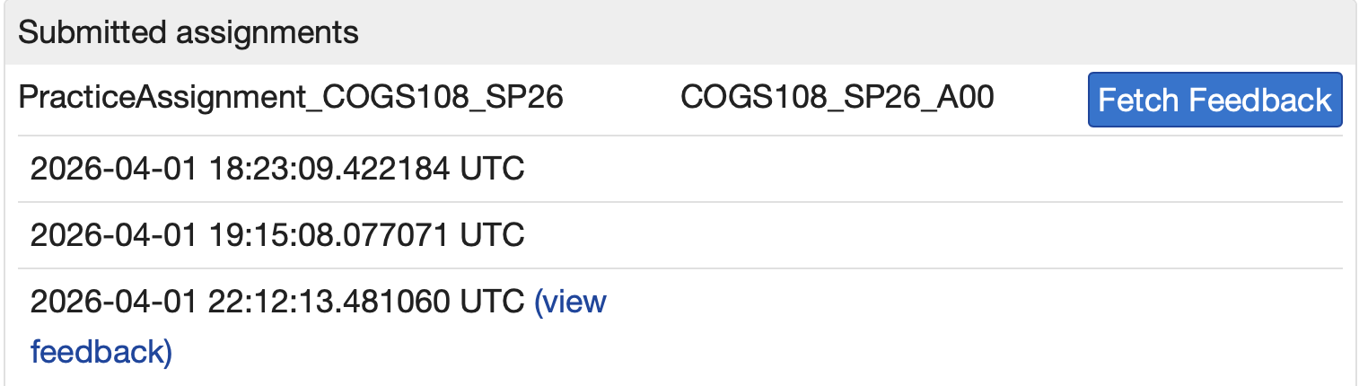
Due dates
A1 and Project Review: Wednesday (04/22)
D3: Friday (04/24)
Reminder:
Datahub Feedback

Slide 3
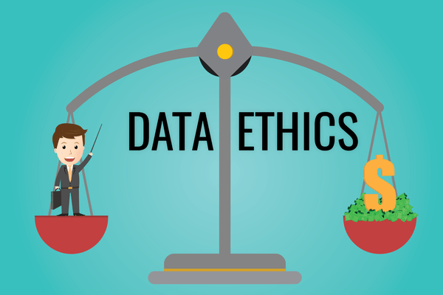
Data Ethics: core ideas
Principles
Respect for persons / autonomy
Beneficence: aim to help
Non-maleficence: avoid harm
Justice: fairness in burdens and benefits
Reminders
Good intentions do not guarantee ethical outcomes
Harms can be indirect, delayed, or unintended
Biased data can produce biased results
A system can be legal, technical, and still unethical

Slide 4
Data Ethics: core ideas
Think like a reviewer
Who are the stakeholders?
Who could be harmed?
What assumptions are built into the data?
Can people contest or appeal decisions?

Slide 5

Privacy, PII
Personally identifiable information (PII)
Direct identifiers: name, SSN, license number
Indirect identifiers can also matter if data are linkable
Location, education, financial, and medical data can become identifying in context

Slide 6
Proxies, and consent
Proxy variables
A feature may stand in for a sensitive trait without naming it directly
That can still create unfair or discriminatory outcomes
Always ask what the variable is really capturing
Informed consent
Participation should be voluntary
People should understand what is collected and the risks
Consent can be withdrawn in many research settings

Slide 7

Strong data science questions
Specific
Measurable
Answerable with obtainable data
Clear about variables, population, and time frame
Narrow enough to do, broad enough to matter

Slide 8
Strong data science questions
Red Flags
Too vague
Undefined outcomes
No clear metric
Requires unavailable data
Asks for causation with only observational data

Slide 9

Evaluation: metrics are not the same as goals
Goodhart’s law
When a measure becomes a target, it stops being a reliable measure
Optimizing the proxy can distort the real goal
Common failure mode
A platform optimizes for clicks, time, or engagement
Those metrics may not represent truth, learning, safety, or well-being

Slide 10
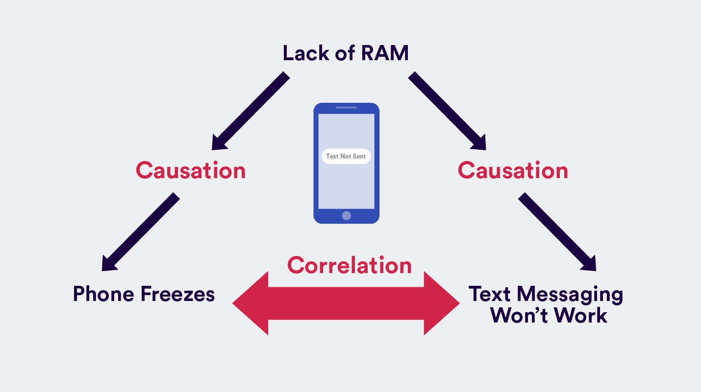
Correlation, causation, and confounding
Correlation tells you
Direction and strength of association
How variables move together
Correlation does NOT tell you
That one variable caused the other
That there is no hidden third variable
That the relationship is meaningful outside the observed setting

Slide 11
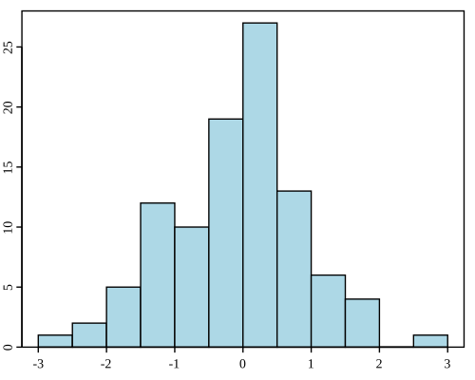
Visualization
Histogram:
one numeric distribution

Slide 12
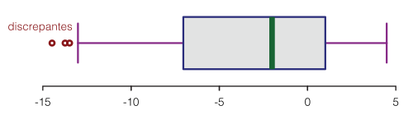
Visualization
Boxplot:
numeric distribution across groups

Slide 13
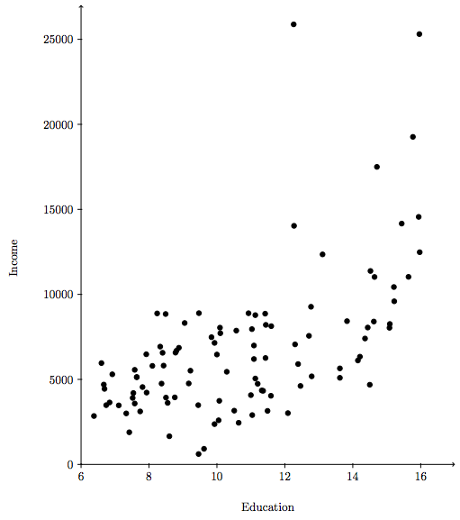
Visualization
Scatterplot:
relationship between two numeric variables

Slide 14
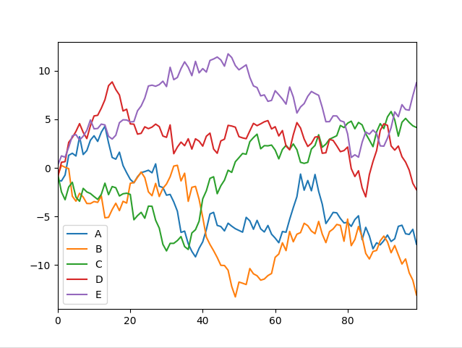
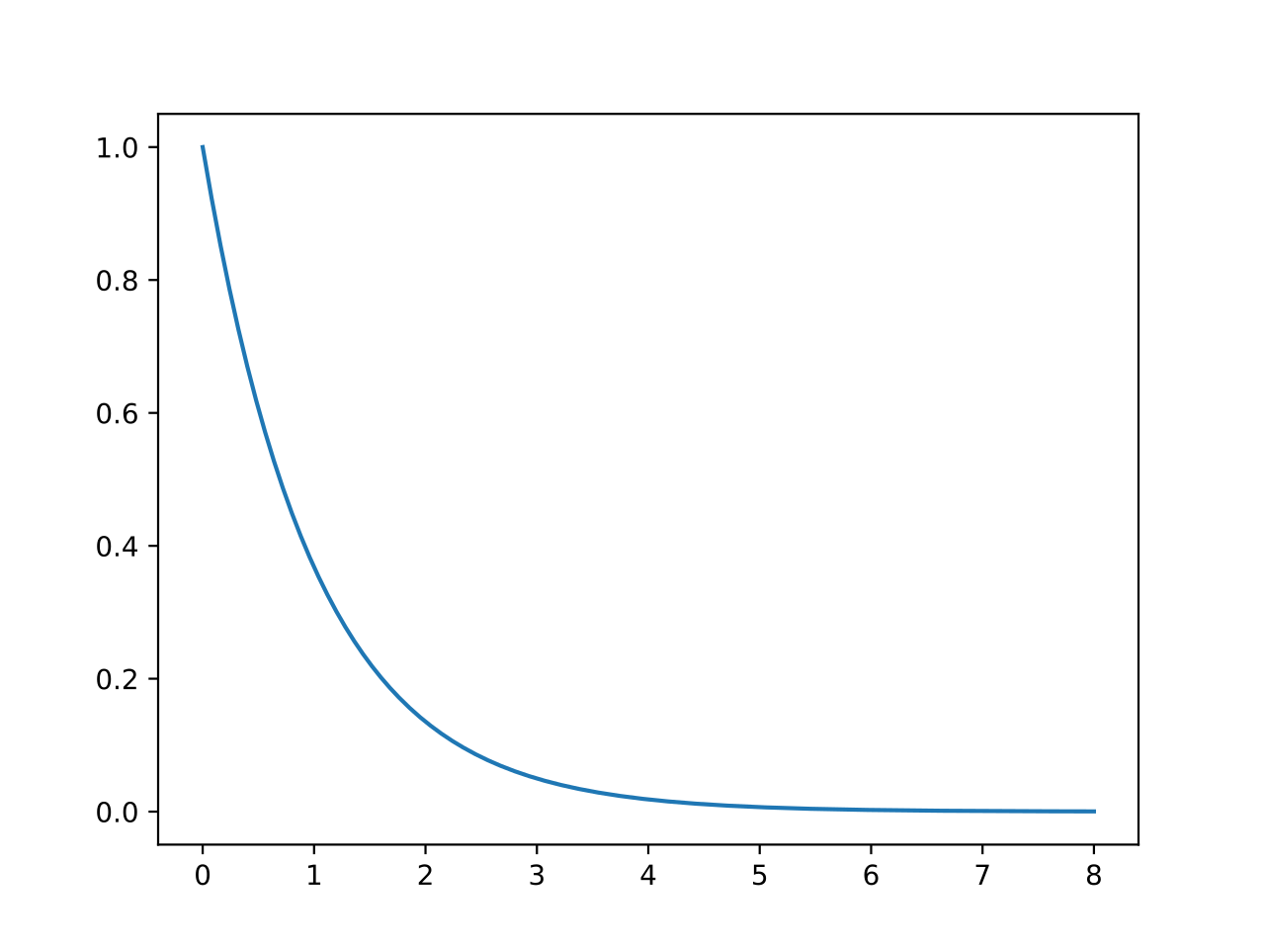
Visualization
Line plot:
change over time

Slide 15
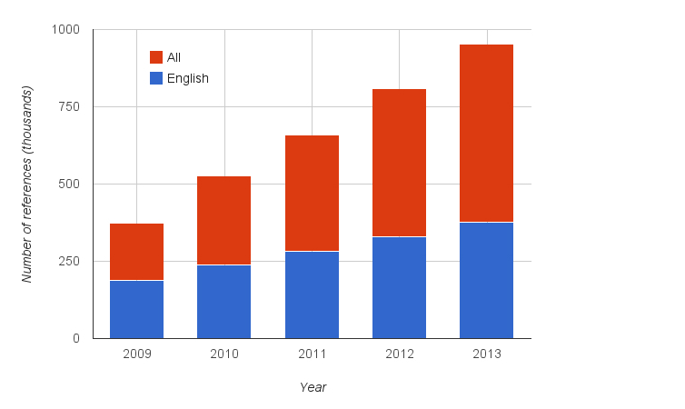
Visualization
Stacked bar chart:
composition/proportions across categories

Slide 16
Visualization choices
General design habits
Use informative titles and labels
Prefer comparisons people can judge accurately
Annotate clearly when it reduces confusion
Avoid decorative choices that hide the pattern

Slide 17


Library choices
seaborn
high-level statistical graphics
matplotlib
detailed control and fine-tuning

Slide 18

Common analysis types
Descriptive
Summarize what is in the data
Counts, means, missingness, tables
Exploratory
Look for patterns and generate ideas
Flexible and discovery-oriented
Inferential
Use sample data to say something about a broader population
Often involves uncertainty estimates
Predictive
Forecast unknown or future outcomes
Accuracy matters more than explanation
Notes:
Summarize what is in the data, Counts, means, missingness, tables
Look for patterns and generate ideas, Flexible and discovery-oriented
Use sample data to say something about a broader population, Often involves uncertainty estimates
Forecast unknown or future outcomes, Accuracy matters more than explanation

Slide 19
Quiz Time
NO Phone, NO Communication, No Notes
Access Code: code here

Slide 20
Your time to …
Work on D3

